Slide 1
Causal Representation Learning
Guangyi Chen
https://chengy12.github.io/
Carnegie Mellon University, Pittsburgh PA, USA
Mohamed bin Zayed University of Artificial Intelligence, Abu Dhabi, UAE
Swarma Pattern, 1st September

Slide 2
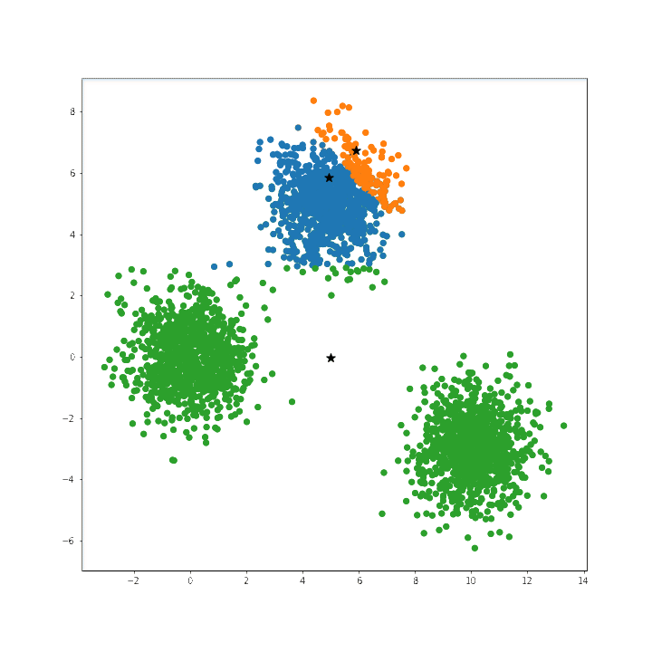
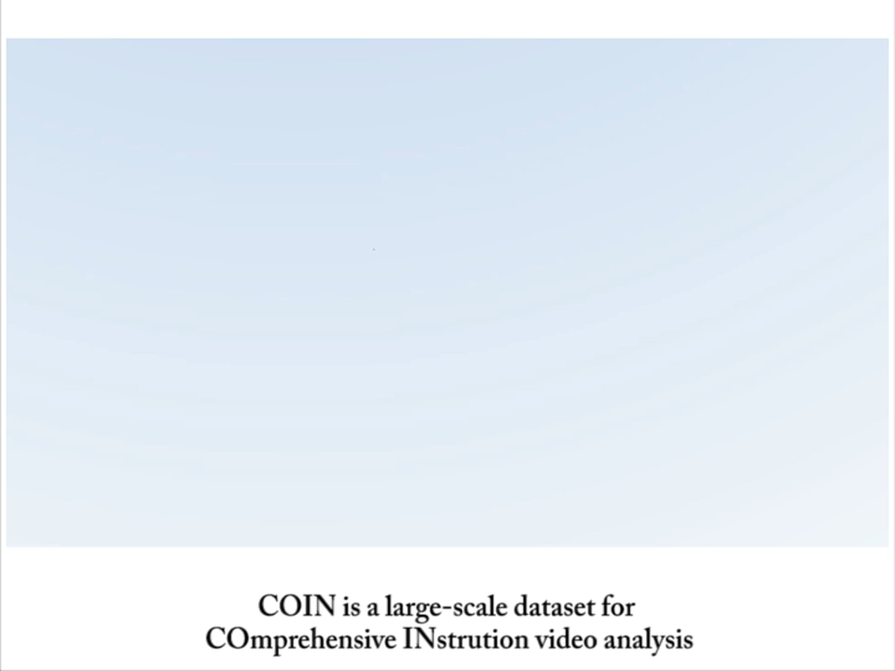
Unsupervised Representation Learning
In most cases, we need to learn the representation in an unsupervised may
We don’t know what we are looking for
Labels are not always available
Labels might not be informative
Massive unsupervised data

Slide 3
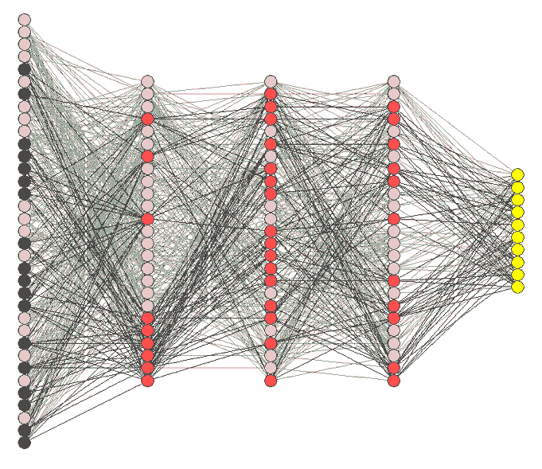





Disentangled Representation
What is good representation?
Speed
Direction
Type
（ ）
（ ）
Compact, discriminative, high-level, informative, independent, disentangled, explainable, controllable

Slide 4
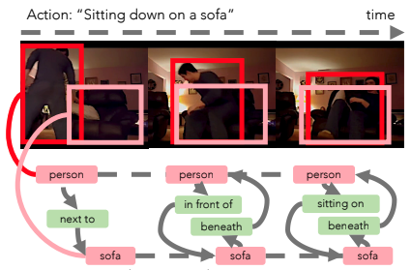
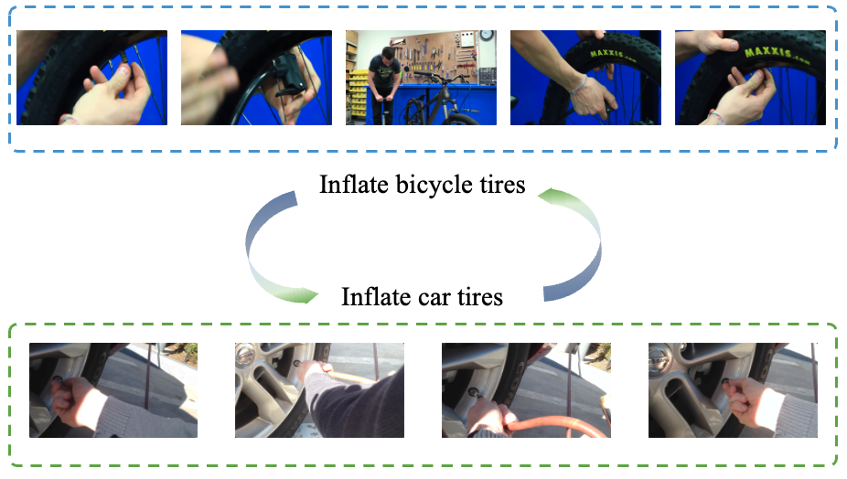

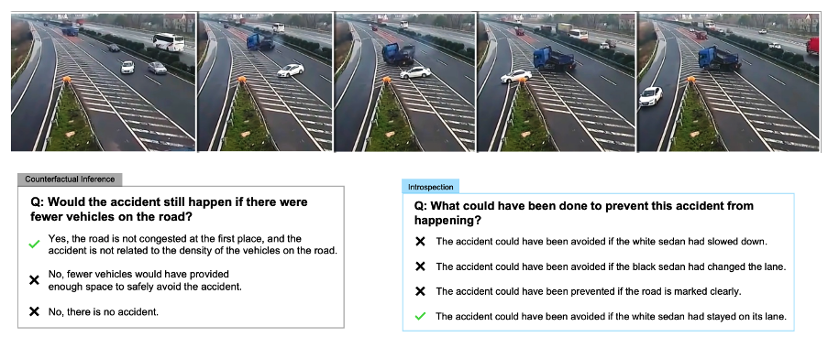
Disentangled Representation
The advantages of disentangled representation
(Ji et al., 2020)
(Li et al., 2023)
Explainable
Transferable
(Xiang et al., 2024)
(Xu et al., 2021)
Controllable
Reasonable
Notes:
Unstructured data

Slide 5
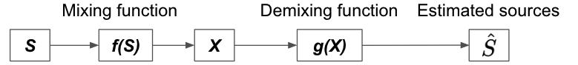
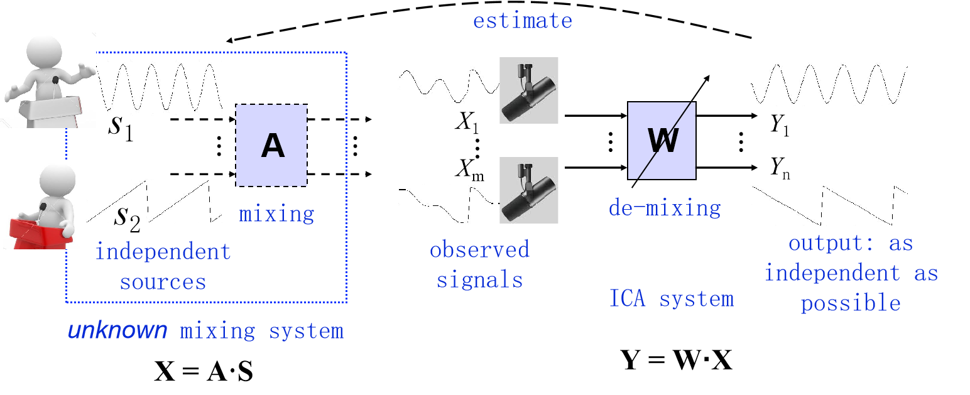

Independent Component Analysis Framework
One potential formalization: Disentanglement via Independent Component Analysis
[Credit to Kun]
Notes:
Data is explained by unobserved and independent latent variables/sources (S)
There exists a mixing function f(S) that transforms sources S to observation X
Disentanglement: recover sources S from observation X

Slide 6
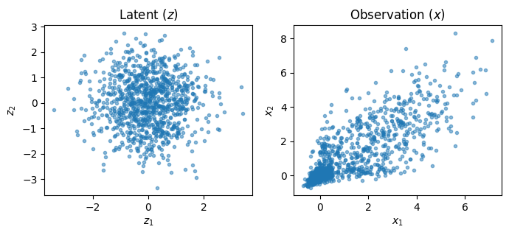
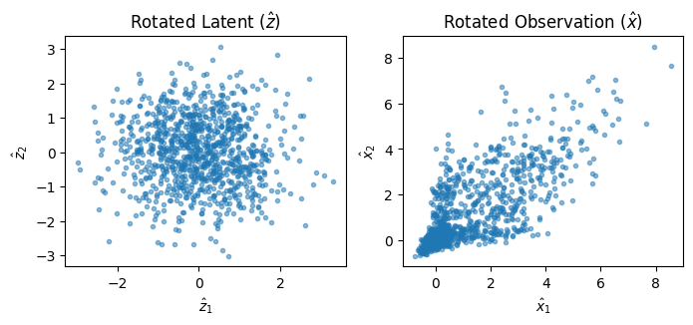
Causal Representation Learning is Hard
For the linear Gaussian case, when we add a rotation on the latent variable, the generated observation distribution is unchanged.
Original generation process
Adding a rotation on the latent variable doesn’t change the observation
We may learn the representations with the entanglement

Slide 7
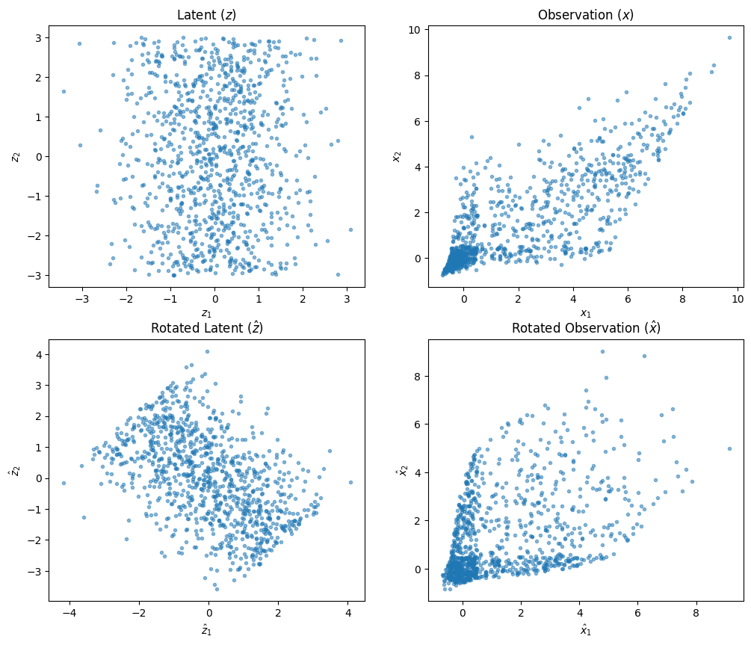

Causal Representation Learning Is Hard
For the linear non-Gaussian case, we can recover the latent variables.
The Non-Gaussian property provides the “changeability” (sufficient change)
By maximizing non-Gaussianity, we could identify true sources.
[Credit to Xiangchen]

Slide 8






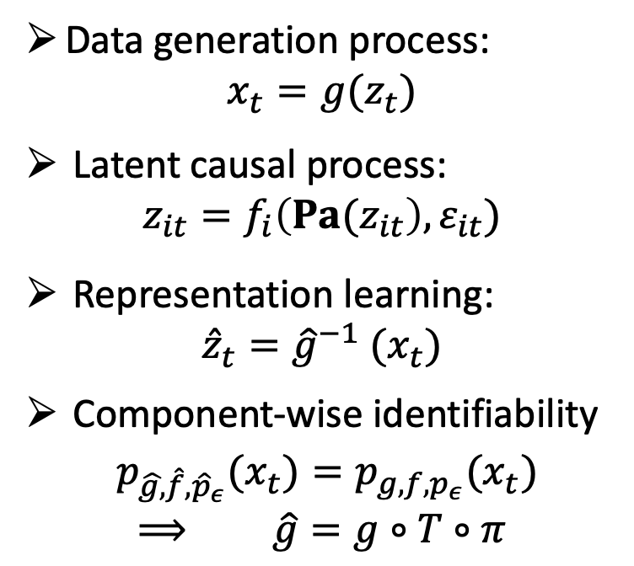

Formulation
Causal representation learning (CRL) aims to recover the data generation process from the observation to obtain the disentangled latent representation.
Data generation process:
$$x_{t}=g(z_{t})$$
Latent causal process:
$$z_{it}=f_{i}\left({Pa(z}_{it}\right),ε_{it})$$
Representation learning:
$${\hat{z}}_{t}={\hat{g}}^{−1} (x_{t})$$
Component-wise identifiability
${p_{\hat{g,}\hat{f},{\hat{p}}_{ε}}(x}_{t})={p_{g,f,p_{ε}}(x}_{t})$
$⟹$ $\hat{g}=g∘T∘π$

Slide 9
Causal Representation Learning
When the learned representation can be identifiable and how to learn?
What can we do if causal representation is learned?
Identification Theorem
Real-world Application

Slide 10
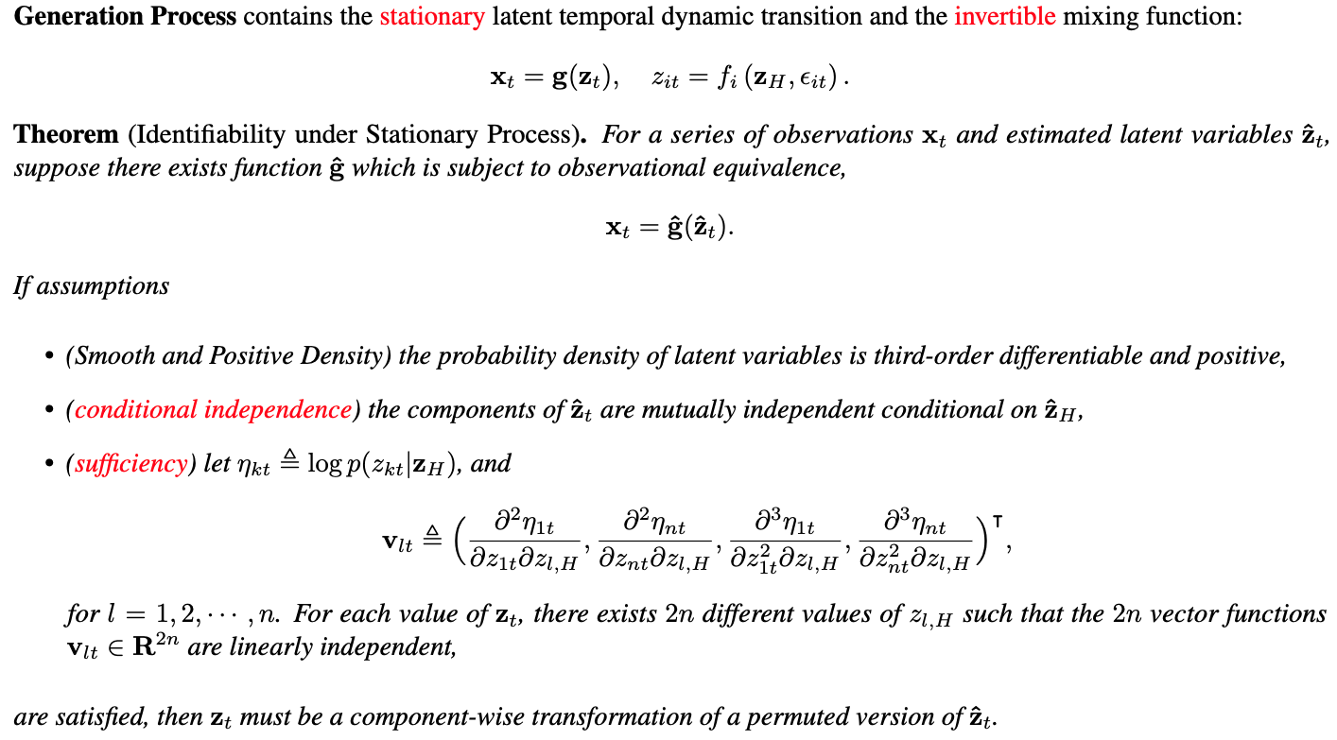
Identification Theorem with Conditional Independence
(Yao, Chen, & Zhang, 2022)

Slide 11




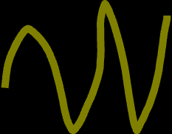
Identification Theorem with Conditional Independence
Stationary: The temporal transition function is fixed for the whole sequence.
Known non-stationary is an opportunity more than a challenge.
Unknown non-stationary cases cannot be identifiable since it is difficult to distinguish the
domain change or variable change.
Invertibility: The observation contains all information about the latent process.
If we cannot recover the missing information, we cannot achieve the identification.
Conditional independence: there are no instantaneous relations among the latent variables. If two variables always change jointly, we cannot say what is the unique effect of each.
Sufficiency: It means that the conditional independent change of the latent variables has sufficient influence and these changes can be captured from the observation. Image: requiring domain index or labels
Video: using the historical state as the side information

Slide 12
Identification under More Challenges
Challenges | Scenarios | Extra Assumption | Reference
Unknown non-stationary | Bioinformatics, Speech, Volleyball Game | Domain index follows the Markov process, Mechanism Sparsity | (Song et al., 2023) (Song et al., 2024) (Li et al., 2024)
Non-invertible mixing function | Occlusion, Video, Motion Blue | Context exists to complete the missing information. | (Chen et al., 2024)
Instantaneous relations | Skeleton, Stock | Sparse relations | (Li et al., 2024)

Slide 13
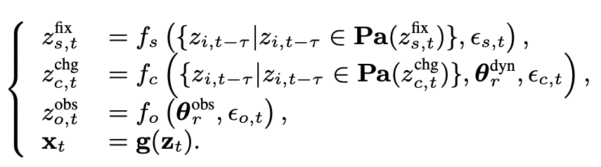
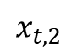
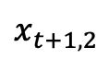
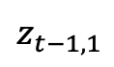
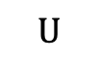
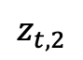
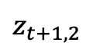

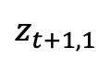
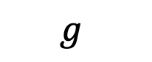
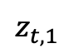

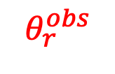
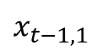
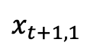
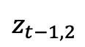
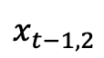
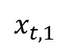
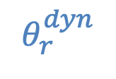

Nonstationary Provides More Information
For the nonstationary case, the domain index can serve as auxiliary variables
$$f$$
$$z_{t−1,1}$$
$$z_{t,1}$$
$$z_{t+1,1}$$
$$θ_{r}^{dyn}$$
Domain information is observed
$$z_{t−1,2}$$
$$z_{t,2}$$
$$z_{t+1,2}$$
$$θ_{r}^{obs}$$
$$U$$
$$g$$
$$x_{t−1,1}$$
$$x_{t,1}$$
$$x_{t+1,1}$$
$$x_{t−1,2}$$
$$x_{t,2}$$
$$x_{t+1,2}$$

Slide 14
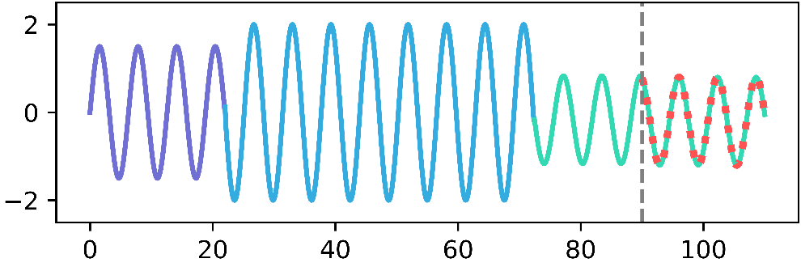
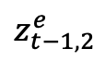
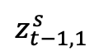
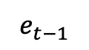
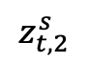
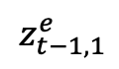
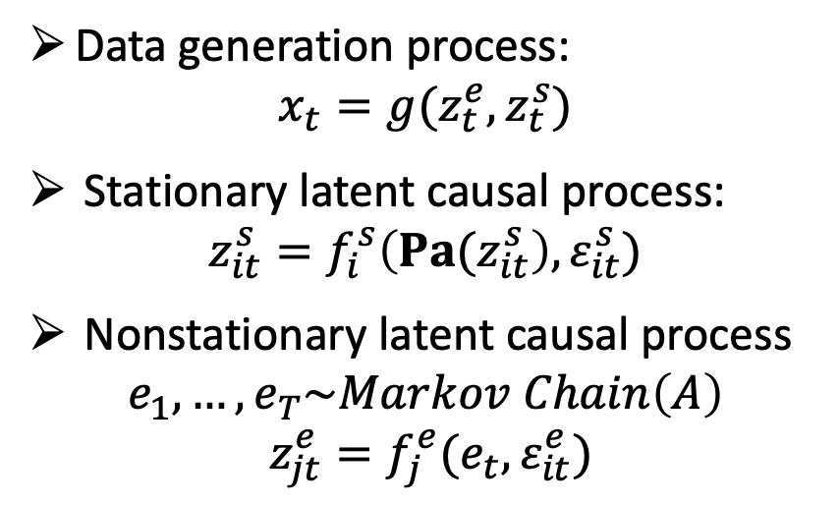
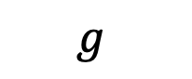
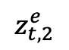
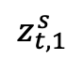


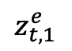
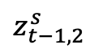
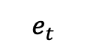
Nonstationary Information Is Unknown
When the nonstationary information cannot be observed, we need extra assumptions.
$$f^{s}$$
$$z_{t−1,1}^{s}$$
$$z_{t,1}^{s}$$
Stationary process
$$z_{t−1,2}^{s}$$
$$z_{t,2}^{s}$$
$$g$$
$$x_{t−1,1}$$
$$x_{t,1}$$
$$x_{t−1,2}$$
$$x_{t,2}$$
Data generation process:
$$x_{t}=g(z_{t}^{e},z_{t}^{s})$$
Stationary latent causal process:
$$z_{it}^{s}=f_{i}^{s}\left({Pa(z}_{it}^{s}\right),ε_{it}^{s})$$
Nonstationary latent causal process
$$e_{1},…,e_{T}\sim Markov Chain\left(A\right)$$
$$z_{jt}^{e}=f_{j}^{e}(e_{t},ε_{it}^{e})$$
Nonstationary process
$$z_{t−1,1}^{e}$$
$$z_{t,1}^{e}$$
$$z_{t−1,2}^{e}$$
$$z_{t,2}^{e}$$
$$f^{e}$$
$$e_{t−1}$$
$$e_{t}$$

Slide 15
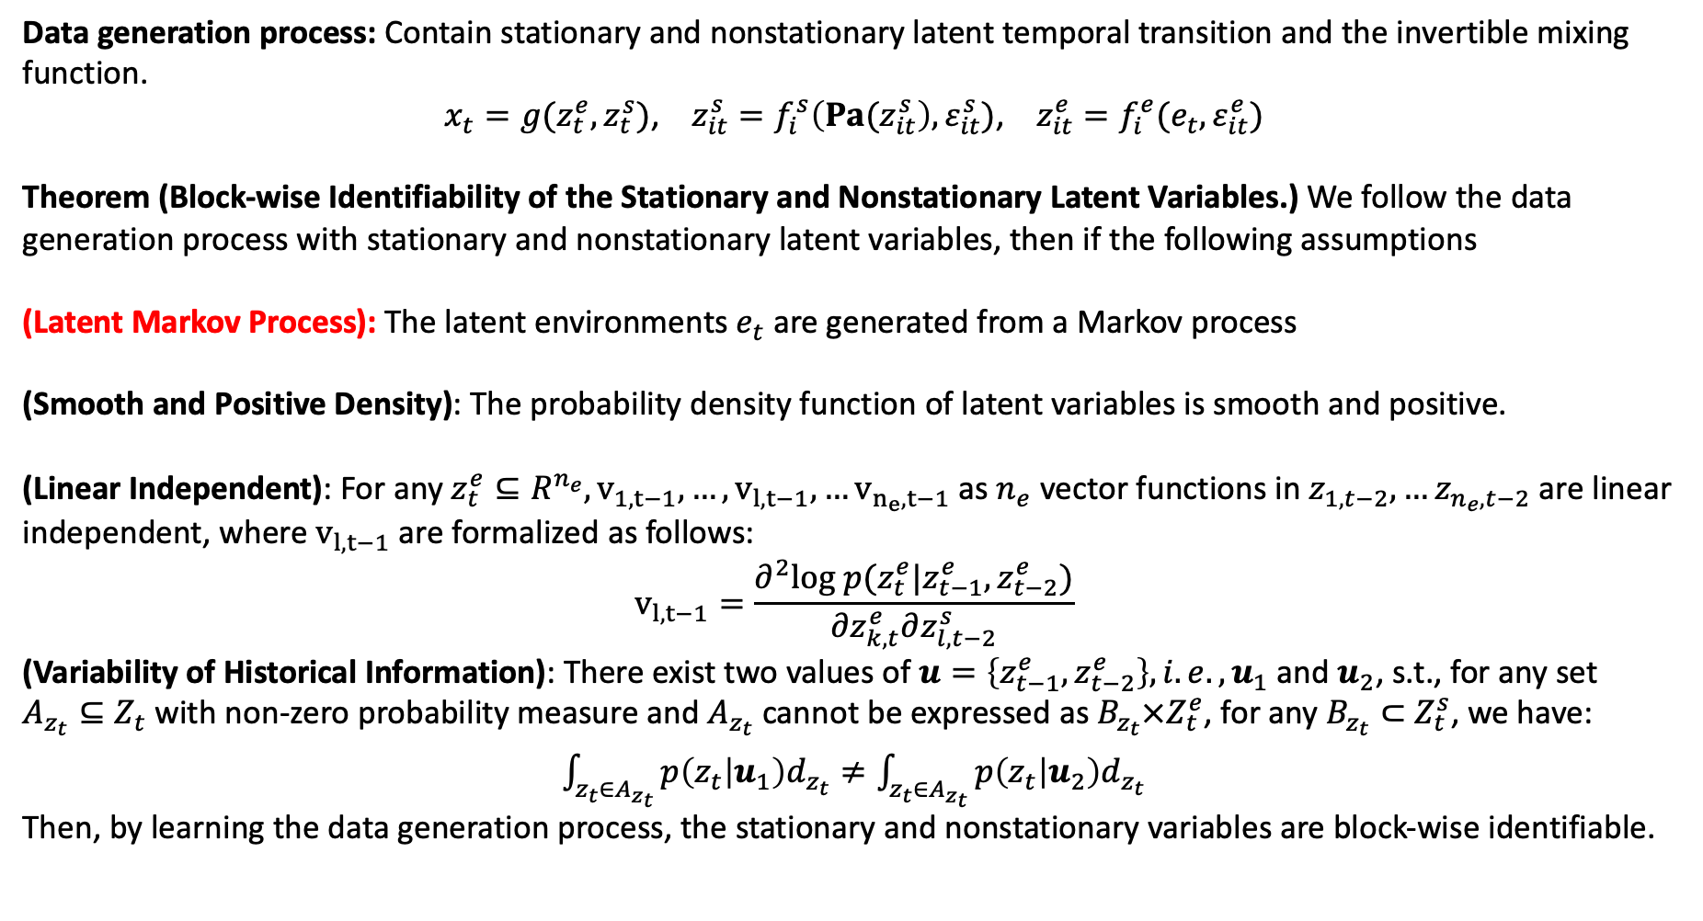
Identification Theorem under Unknown Nonstationary
Data generation process: Contain stationary and nonstationary latent temporal transition and the invertible mixing function.
$x_{t}=g(z_{t}^{e},z_{t}^{s})$, $z_{it}^{s}=f_{i}^{s}\left({Pa(z}_{it}^{s}\right),ε_{it}^{s})$, $z_{it}^{e}=f_{i}^{e}(e_{t},ε_{it}^{e})$
Theorem (Block-wise Identifiability of the Stationary and Nonstationary Latent Variables.) We follow the data generation process with stationary and nonstationary latent variables, then if the following assumptions
(Latent Markov Process): The latent environments $e_{t}$ are generated from a Markov process
(Smooth and Positive Density): The probability density function of latent variables is smooth and positive.
(Linear Independent): For any $z_{t}^{e}⊆R^{n_{e}},v_{1,t−1},…,v_{l,t−1},…v_{n_{e},t−1}$ as $n_{e}$ vector functions in $z_{1,t−2},…z_{n_{e},t−2}$ are linear independent, where $v_{l,t−1}$ are formalized as follows:
$$v_{l,t−1}=\frac{∂^{2}log p(z_{t}^{e}|z_{t−1}^{e},z_{t−2}^{e})}{∂z_{k,t}^{e}∂z_{l,t−2}^{s}}$$
(Variability of Historical Information): There exist two values of $u=\left\{z_{t−1}^{e},z_{t−2}^{e}\right\}, i.e., u_{1}$ and $u_{2}$, s.t., for any set $A_{z_{t}}⊆Z_{t}$ with non-zero probability measure and $A_{z_{t}}$ cannot be expressed as $B_{z_{t}}×Z_{t}^{e}$, for any $B_{z_{t}}⊂$ $Z_{t}^{s}$, we have:
$\int_{z_{t}∈A_{z_{t}}}{p\left(z_{t} | u_{1}\right)d_{z_{t}}}≠\int_{z_{t}∈A_{z_{t}}}{p\left(z_{t} | u_{2}\right)d_{z_{t}}}$
Then, by learning the data generation process, the stationary and nonstationary variables are block-wise identifiable.
(Li et al., 2024)

Slide 16
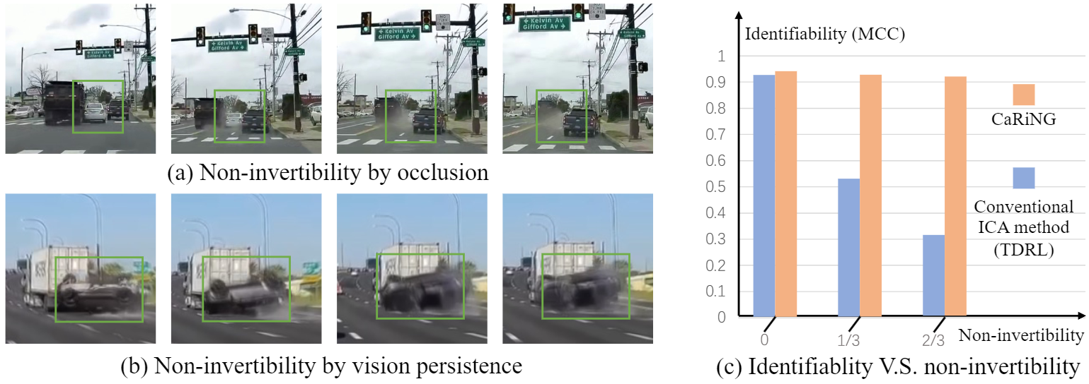
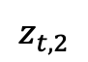
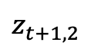

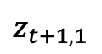
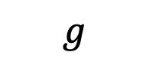





Identification under Non-Invertibility
Usually, the maxing function is non-invertible, caused by occlusion or mappings like 3d-2d
Non-invertible data generation process:
$$x_{t}=g(z_{t:t−τ})$$
Latent causal process:
$$z_{it}=f_{i}\left({Pa(z}_{it}\right),ε_{it})$$
There exists a mapping from x to z, such as:
$$z_{t}=m(x_{t:t−u})$$
Key intuition: leveraging the context to recover the lost information.
$$f$$
$$z_{t−1,1}$$
$$z_{t,1}$$
$$z_{t+1,1}$$
$$z_{t−1,2}$$
$$z_{t,2}$$
$$z_{t+1,2}$$
$$g$$
$$x_{t−1,1}$$
$$x_{t,1}$$
$$x_{t+1,1}$$
$$x_{t−1,2}$$
$$x_{t,2}$$
$$x_{t+1,2}$$

Slide 17

Identification under Non-Invertibility
(Chen et al., 2024)

Slide 18






















Instantaneous Dependency
Current methods assume the absence of instantaneous dependencies, which may not hold true when the sampling frequency is low, or with solid relations.
$$f$$
$$z_{t−1,1}$$
$$z_{t,1}$$
$$z_{t+1,1}$$
Data generation process:
$$x_{t}=g(z_{t})$$
Latent causal process with time-delay and instantaneous dependencies:
$$z_{it}=f_{i}\left({Pa_{d}(z}_{it}\right),Pa_{e}(z_{it}),ε_{it})$$
$$z_{t−1,2}$$
$$z_{t,2}$$
$$z_{t+1,2}$$
$$g$$
$$x_{t−1,1}$$
$$x_{t,1}$$
$$x_{t+1,1}$$
$$x_{t−1,2}$$
$$x_{t,2}$$
$$x_{t+1,2}$$

Slide 19


Identification Theorem under Instantaneous Dependency
Data generation process: Contain stationary and nonstationary latent temporal transition and the invertible mixing function.
$x_{t}=g(z_{t})$,${ z}_{it}=f_{i}\left({Pa_{d}(z}_{it}\right),Pa_{e}(z_{it}),ε_{it})$
Theorem 1 (Relationships between Ground-truth and Estimated Latent Variables): For a series of observations $x_{t}$ and estimated latent variables ${\hat{z}}_{t}$, suppose the process subject to observational equivalence $x_{t}=\hat{g}\left(\hat{z_{t}}\right).$Let $c_{t}=\left\{z_{t−1},z_{t}\right\}$ and $M_{c_{t}}$ be the variable set of two consecutive timestamps and the corresponding Markov network respectively. Suppose the following assumptions hold
(Smooth and Positive Density): The probability density function of latent variables is smooth and positive.
(Sufficient Variability): Denote ${|M}_{c_{t}}|$ as the number of edges in Markov network $M_{c_{t}}$, let $w(m)$ are linearly independent.
$$w\left(m\right)=(\frac{∂^{3}\log{p\left(c_{t} | z_{t−2}\right)}}{∂c_{1,t}^{2}∂z_{m,t−2}},…\frac{∂^{3}\log{p\left(c_{t} | z_{t−2}\right)}}{∂c_{2n,t}^{2}∂z_{m,t−2}})⨁(\frac{∂^{2}\log{p\left(c_{t} | z_{t−2}\right)}}{∂c_{1,t}∂z_{m,t−2}},…\frac{∂^{2}\log{p\left(c_{t} | z_{t−2}\right)}}{∂c_{2n,t}∂z_{m,t−2}})⨁(\frac{∂^{3}\log{p\left(c_{t} | z_{t−2}\right)}}{∂c_{i,t}∂c_{j,t}∂z_{m,t−2}})$$
Then $\frac{∂c_{i,t}}{∂{\hat{c}}_{k,t}}⋅\frac{∂c_{i,t}}{∂{\hat{c}}_{l,t}}=0,\frac{∂c_{i,t}}{∂{\hat{c}}_{k,t}}⋅\frac{∂c_{j,t}}{∂{\hat{c}}_{l,t}}=0,\frac{∂^{2}c_{i,t}}{∂{\hat{c}}_{k,t}∂{\hat{c}}_{l,t}}=0$
Theorem 2 (Component-wise Identification of Latent Variables with instantaneous dependencies.) Except for the smooth, positive density and sufficient variability assumptions, we further make the following assumption:
(Latent Process Sparsity): For any $z_{i,t}$, the intimate neighbor set of $z_{i,t}$ is an empty set.
When the observational equivalence is achieved with the minimal number of edges of the estimated Markov network of ${\hat{M}}_{c_{t}}$, then the latent variables are component-wise identifiable.
(Li & Chen et al, 2024)

Slide 20































Generative Learning Framework
Auto-Encoder Model: Estimates the mixing function $x_{t}=g(z_{t})$ and de-mixing function ${\hat{z}}_{t}={\hat{g}}^{−1} (x_{t})$. Invertibility is enforced by reconstruction loss.
Prior Network: Estimates the prior distribution $p(z_{t}|z_{H})$ by learning the inverse dynamics $f_{z}^{−1}$, by change of variable $p\left(z_{t} | z_{H}\right)=p_{ε}\left(f_{z}^{−1}\left(z_{t}, z_{H}\right)\right)|\frac{∂f_{z}^{−1}}{∂z_{t}}|$. By constraining this prior, we encourage the conditional independence.
…
Sequential encoder to leverage the context to recover the lost information
Autoregressive hidden Markov module to estimate transition matrix of the unknown non-stationary.
$${\hat{x}}_{1}$$
$${\hat{x}}_{2}$$
$${\hat{x}}_{T}$$
$$ε$$
$$ε$$
Decoder
$$ℒ_{KLD}$$
Decoder
$$ℒ_{KLD}$$
Decoder
…
$${\hat{ε}}_{2}$$
$${\hat{ε}}_{3}$$
$${\hat{c}}_{1}$$
$${\hat{c}}_{2}$$
$${\hat{c}}_{T}$$
…
$${\hat{z}}_{1}$$
$${\hat{f}}_{z}^{−1}$$
$${\hat{z}}_{2}$$
$${\hat{f}}_{z}^{−1}$$
$${\hat{z}}_{T}$$
$$ℒ_{Recon}$$
$$ℒ_{HMM}$$
ARHMM
Encoder
Encoder
Encoder
SeqEnc
SeqEnc
SeqEnc
…
$$x_{1}$$
$$x_{2}$$
…
$$x_{T}$$

Slide 21
Summary of “Conditional Independence”
In the linear case, identifiability can be achieved through non-Gaussianity.
When the mixing function is non-linear, additional information is needed to ensure the “change” is sufficient, such as auxiliary variables like domain index.
For stationary time series, auxiliary variables are not required; historical data can be used instead.
In the case of non-stationary time series, the observed domain index provides sufficient change, no matter whether it involves dynamic or observational variations.
When non-stationarity is unknown, additional assumptions, such as a Markov prior, may be necessary.
If the mixing function is non-invertible, the lost information can be recovered from the context.
Sparsity can help address instantaneous dependencies.

Slide 22
Causal Representation Learning with Sparsity
Conditional independence requires more information on the observed distribution for sufficient change.
Sparsity provides the constraints on the data structures.
Sparsity
Conditional
independence
Simplicity Sufficiency

Slide 23


Causal Representation Learning with Sparsity
Sparsity provides the constraints on the data structures.
(Zheng et al., 2024)
Notes:
Too dense, too sparse

Slide 24



Structural Sparsity
Sparsity provides the constraints on the data structures.
Implication: for every latent source $s_{i}$, there exists a set of observed variable(s) such that $s_i$ is the only latent source that participates in the generation of all observed variables in the set.
Graphically, for every latent source $s_{i}$, there exists a set of observed variable(s) such that the intersection of their/its parent(s) is $s_{i}$
Example: for $s_{1}$, there exists $x_{1}$ and $x_{4}$ such that the intersection of their parents is $s_{1}$
Notes:
One latent variable affects a set of observations uniquely.

Slide 25
Structural Sparsity
Sparsity as a principle of simplicity
Important in the disentanglement of latent factors both empirically and theoretically.
In causality, various versions of Occam’s razor are fundamental: e.g., faithfulness, the minimality principle.
More likely to hold when the influence is “simple”
In biology, active interactions may often be sparse [Busiello et al., 2017].
In physics, a relatively small set of laws govern complicated observed phenomena. [Einstein, 1905; Nash, 1963]
[Credit to Yujia]

Slide 26


Undercomplete Nonlinear ICA with Structural Sparsity
Structural sparsity can provide identification for the undercomplete Nonlinear ICA.
Notes:
encourages the variability between the influences of each source. For each source, its influence on the observations should be as distinctive as possible, which is correlated with the sparsity of the mixing matrix

Slide 27




Sparsity and Sufficiency
Can Sparsity and Sufficiency work together? Yes
Sparsity V.S. Sufficiency
Sparsity + Sufficiency

Slide 28

Non-independent Sources
Structure Sparsity and Conditional Independence both require independent sources.
However, in complex real work, there are relations among the latent variables
Static: images with relational latent concepts; Dynamic: low - frequency sampling

Slide 29


How Can We Identify from Sufficient Change
(Zhang et al. 2024)
Notes:
Give the intuition of both a and b

Slide 30






DAG V.S. Markov network
Markov network describes the undirected relationship among variables
$$\left\{Z_{i}, Z_{j}\right\}∈E\left(M_{Z}\right) iff Z_{i}∦Z_{j}∣ Z_{\left[n\right]∖\{i,j\}}$$
Intimate neighbors
Notes:
Give the intuition of both a and b

Slide 31




How Can We Identify from Sufficient Change
If two variables $z_{i}$ and $z_{j}$ are adjacent in the ground truth Markov network, then the estimated ${\hat{z}}_{i}$ and ${\hat{z}}_{j}$ are adjacent. (invertibility)
When the estimated Markov network is with minimal edges, then $M_{Z}≅M_{\hat{Z}}$
Each latent variables is recovered as a function of itself and its intimate neighbors in the Markov network
When the structure of latent variables is as sparse as that intimate neighbors are empty, we can establish the component-wise identification.
A’s neighbor B brings confusion only when there are no other neighbors C not adjacent to B.
Non-linear ICA (with auxiliary variables) may be viewed as a special case
Notes:
A affect C
B cannot affect C without A

Slide 32

Structure Sparsity and Sparsity Constraints
Sparsity Constraints: Make sure the learned structure of latent variables is somehow equivalent to the group truth structure
Structure Sparsity: When the structure of latent variables is as sparse as intimate neighbors are empty, we can establish the component-wise identification.
Temporal Infomation: The historical information may provide side information to further disentangle the instantaneous intimate variables.

Slide 33





How to Add Constraints
Auto-Encoder Model: Estimates the mixing function $x_{t}=g(z_{t})$ and de-mixing function ${\hat{z}}_{t}={\hat{g}}^{−1} (x_{t})$. Invertibility is enforced by reconstruction loss.
Prior Network: Estimates the prior distribution $p(z_{t}|z_{H},z_{C})$ by learning the inverse dynamics $f_{z}^{−1}$, by change of variable $p\left(z_{t} | z_{H},z_{C}\right)=p_{ε}\left(f_{z}^{−1}\left(z_{t}, z_{H},z_{C}\right)\right)|\frac{∂f_{z}^{−1}}{∂z_{t}}|$. By constraining this prior, we encourage the conditional independence.
Sparsity: Adding the L1 norm on the Jacobin matrix of $f_{z}^{−1}$

Slide 34

Synthetic Experiments
Apply a 2-layer MLP as the transition function and a random three-layer MLP for mixing.
Consider both the stationary scenario and non-stationary scenarios. For non-stationary scenarios, there may be only casual dynamic changes or both casual dynamic changes and global observations vary.
To add changes to the causal dynamic, we vary the values of the first layer of the MLP.
The global change component is sampled from i.i.d Gaussian distribution whose mean and variance are modulated by domain index.
Compared with baseline betaVAE, i-VAE/ TCL with independent factors, and LEAP which only models nonstationary noise.
Mean Correlation Coefficient (MCC) is used to evaluate the learned representation.

Slide 35



Application: Video Reasoning
Video reasoning aims to answer the neural language reasoning questions based on the video content, whose challenge lies in understanding the latent causal process.
Credited to the SUTD-TrafficQA dataset (Xu. et.al. 2021)

Slide 36


Compared with Existing VideoQA methods
Once we identify the causal dynamics, we can efficiently conduct video reasoning (such as attribution and counterfactual questions) as a causal inference process.
Formulate VideoQA as cross-modality matching.
Rely on question-answer (QA) pairs, Learn relations
Don’t require the QA pairs.
Can efficiently answer the attribution and counterfactual questions
(Chen et al. 2024)

Slide 37
Overall Framework
In the training, we learn the latent causal process from normal videos by self-supervision
During inference, we first identify the root cause and use it to select answer

Slide 38

Algorithm Details
Identify root cause: we find the root cause of abnormal videos by comparing them with learned causal structures. Specifically, we find the variable with a notable shift in the learned local causal processes.
${x′}_{C}=arg \max_{t,i}\left\|{\hat{x}′}_{t,i}−{x′}_{t,i}\right\|$,
Or identify the variable that needs outlier noise for reconstruction:
${x′}_{C}=arg \max_{t,i}{{\hat{ε}}_{t,i}}$ , ${\hat{ε}}_{t,i}=\min_{ε_{k}}\left\|{\hat{x}′}_{t,i}(ε_{k})−{x′}_{t,i}\right\|$
Counterfactual prediction: 1) Estimate unique characters of the query video; 2) Change the state into the counterfactor; 3) Predict with estimated characters and counterfactual state.

Slide 39
Showcase of Experimental Results
We can identify the causal relations and thus find the root cause.

Slide 40

Application: Few-shot Action Recognition
Few-shot action recognition targets to efficiently transfer the learned action recognition knowledge into the new domain with few-shot examples.
Credited to the Something-Else dataset (Materzynska. 2020)

Slide 41

Application: Few-shot Action Recognition
Key insight: Despite different representations of actions, the underlying physical laws are invariant across different actions.
Once the causal dynamic model is identified, we fix the temporal dynamic transition function (in each domain) as a constraint to adapt to novel data.
(Li & Chen et al., 2024)

Slide 42


Quantitative Experimental Results
Significantly improve the few-shot action recognition performance over previous SOTAs
Also performs well in compositional action recognition task

Slide 43
Takeaway Points
Conditional independence constraint leverages the sufficient change of observed distribution to establish the identification.
The identification results can be extended to more challenging scenarios, such as unknown non-stationary, non-invertibility, and instantaneous relations.
The generative framework encourages conditional independence by adding the constraint between the learned posterior and conditional independent prior.
Sparsity is another dual principle focusing on data structure
Sparsity and Conditional independence can work together to provide more general identification results
Learning causal representation can benefit lots of applications such as video reasoning, few-shot action recognition, and so on.

Slide 44
CRL Workshop @NeurIPS 2024
https://crl-community.github.io/neurips24.html

Slide 45
References
[1] Yao, W., Chen, G., and Zhang, K., “Temporally disentangled representation learning.” NeurIPS, 2022.
[2] Chen, G., Shen, Y., Chen, Z., Song, X., Sun, Y., Yao, W., Liu, X., and Zhang, K., "CaRiNG: Learning Temporal Causal Representation under Non-Invertible Generation Process." ICML, 2024.
[3] Song, X., Yao, W., Fan, Y., Dong, X., Chen, G., Niebles, J.C., Xing, E., and Zhang, K., "Temporally disentangled representation learning under unknown nonstationarity." NeurIPS, 2023.
[4] Li, Z., Cai, R., Yang, Z., Huang, H., Shen, Y., Chen, Z., Song, X., Hao, Z., Chen, G., and Zhang, K., “ When and How: Learning Identifiable Latent States for Nonstationary Time Series Forecasting. ” Preprint, 2024.
[5] Li, Z., Shen, Y., Zheng, K., Cai, R., Song, X., Gong, M., Hao, Z., Zhu, Z., Chen, G., and Zhang, K., “On the Identification of Temporally Causal Representation with Instantaneous Dependence.” Preprint, 2024.
[6] Chen, G., Li, Y., Liu, X., Li, Z., Al Suradi, E., Wei, D., and Zhang, K., LLCP: Learning Latent Causal Processes for Reasoning-based Video Question Answer. ICLR, 2024.
[7] Li, Y., Chen, G., Abramowitz, B., Anzellotti, S., and Wei, D., “Learning Causal Domain-Invariant Temporal Dynamics for Few-Shot Action Recognition.” ICML, 2024.
Notes:
Thanks for your listening, Please refer to our papers for more details. We have included some recent updates there.

Slide 46
Thanks for your listening

Slide 47









Causal Representation Learning
Given the video data, causal representation learning (CRL) aims to recover the data generation process from the observation to obtain the disentangled latent representation.
$$f$$
$$z_{t−1,1}$$
$$z_{t,1}$$
$$z_{t+1,1}$$
Data generation process:
$$x_{t}=g(z_{t})$$
Latent causal process:
$$z_{it}=f_{i}\left({Pa(z}_{it}\right),ε_{it})$$
Representation learning:
$${\hat{z}}_{t}=\hat{g} (x_{t})$$
$$z_{t−1,2}$$
$$z_{t,2}$$
$$z_{t+1,2}$$
$$g$$
$$x_{t−1,1}$$
$$x_{t,1}$$
$$x_{t+1,1}$$
$$x_{t−1,2}$$
$$x_{t,2}$$
$$x_{t+1,2}$$

